Slide 1


Santosh Kumar Kar
skkar.2k2@gmail.com

Slide 2
CHAPTER – 8
Feign
Santosh Kumar Kar,
skkar.2k2@gmail.com

Slide 3
What is Feign
Netflix provides Feign as an abstraction over REST-based calls, by which microservices can communicate with each other, but developers don't have to bother about REST internal details.
Developer doesn’t have to know the details of a REST API. Microservice developers only concentrate on business logic, so Spring addresses this issues and comes with Feign Client, which works on the declarative principle. We have to create an interface/contract, then Spring creates the original implementation on the fly, so a REST-based service call is abstracted from developers

Slide 4
What is Feign
Another framework from Netflix
A declarative web service client (Rest client)
Makes writing web service clients easier
Allows writing REST services with No Implementation Code
Alternate to RestTemplate

Slide 5
Recall RestTemplate ☺
RestTemplate restTemplate = new RestTemplate(); Order order = restTemplate.getForObject("http://localhost:8080/order/{0}", Order.class, 111);

Slide 6
Writing Feign
Define interfaces for your REST client code
Annotate interface with Feign annotation
Annotate methods with Spring MVC annotation
Spring will implement code for you to call REST services

Slide 7

@EnableFeignClients in main class
@SpringBootApplication
@EnableFeignClients public class FeignClientWithRibbonApplication { public static void main(String[] args) { SpringApplication.run(FeignClientWithRibbonApplication.class, args); } }

Slide 8
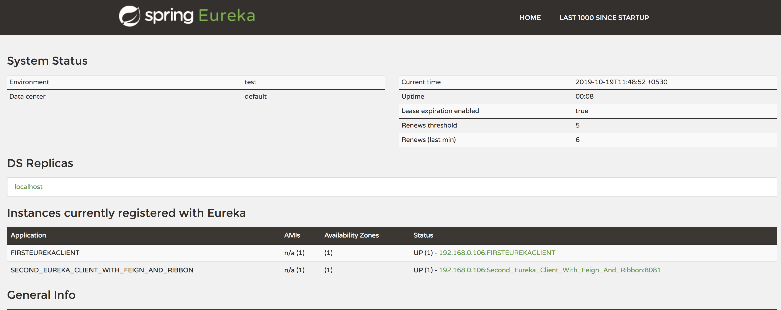

Make sure the client is running and discovered in Eureka

Slide 9

Write Interface for Feign Client
@FeignClient(name="FIRSTEUREKACLIENT") public interface EmployeeFeignClient { @GetMapping("/employee/{id}") Employee getEmployeeById(@PathVariable("id") long empId); @GetMapping("/employee") List<Employee> getAllEmployee();
}
Mapping should be exactly same as used in other Micro service

Slide 10

Write the controller, use FeignClient methods
@RestController public class MsgControllerWithEureka { @Autowired private EmployeeFeignClient employeeFeignClient;
:
: <Rest controller methods here…>
:
:

Slide 11
Write the controller, use FeignClient methods
@GetMapping("/empservice/{id}") public Employee readEmpFromEmpFeignClient(@PathVariable("id") long empId) { /* This is how we can communicate with another micro-service */ Employee emp = employeeFeignClient.getEmployeeById(empId); return emp; } @GetMapping("/empservice") public List<Employee> readEmpFromEmpFeignClient() { List<Employee> emp = employeeFeignClient.getAllEmployee(); return emp; } }

Slide 12

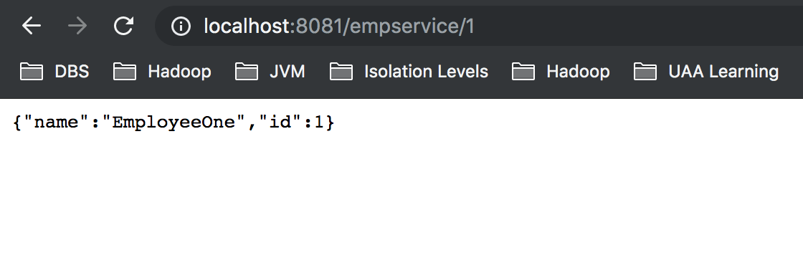
Now access the service

Slide 13

Questions
Send to skkar.2k2@gmail.com

